Slide 1
Market Design with Blockchain Technology
Authored by Katya Malinova and Andreas Park
Presented by: Bill Xiao
Notes:
Andreas Park is an Associate Professor of finance at the University of Toronto, where he has been a faculty member since 2003. He currently serves on the Ontario Security Commission's Market Structure Advisory Committee.
Katya Malinova is also Associate Professor (with tenure) at University of Toronto.

Slide 2
Content
Background on Blockchain Market Design Features
Model Assumptions
Public and Transparent Setting
Private and Opaque Setting
Public and Opaque Setting
Welfare Comparison of Different Setting

Slide 3
Blockchain Market Features
Blockchain technology enables the direct, peer-to-peer digital transfer of value
Blochian allows a decentralized ledger of transactions while most current markets require a centralized ledger to track records
Ownership records and transactions are possibly visible to all parties in the network
Notes:
All asset transfers require a mechanism to change the record of ownership. At present, most such records are kept in centralized ledgers that can only be accessed and modified by select, highly trusted parties; examples are bank accounts. In contrast, blockchain technology to change records in distributed ledgers that can be accessed and modified by anyone and not just trusted intermediaries.

Slide 4
Privacy Implementation Design of Blockchain Market
Public and Transparent design
Private and Opaque design
Public and Opaque design
Investors can identify one another
The ledger is publicly visible
This is the benchmark setting
Investors can only see the holdings of the IDs that they own.
The ledger is not visible to investors, and each investor has a single ID.
Thus the IDs of any specific investors cannot be identified.
The ledger is publicly visible
But investors have multiple IDs, and IDs that belong to a single large investor cannot be identified by other investors.
Thus an investor’s total holdings cannot be inferred.
Notes:
One of the important design feature of Blockchain Market is the privacy design. Market participants often prefer privacy, even when full transparency may be socially desirable. Blockchain designers may choose to implement privacy in different ways,

Slide 5
Which design is better?
Investor trading behavior
Trading costs
Investor welfare
Notes:
This paper study how the three implementation designs affects investor trading behavior, trading costs, and investor welfare, in a theoretical model of intermediated and peer-to-peer trading.

Slide 6
Model Assumptions - General
The model assumes three types of market participants: two large institutional investors, a continuum of small investors and a group of risk-averse intermediaries.
Trading occurs repeatedly, and each period one large investor experiences a liquidity shock.
The liquidity-seeking investor can trade with small investors, who are costly to find, with intermediaries, who require compensation in exchange for taking a risky inventory and with another large investor.
By construction, the welfare optimum for large investors obtains when the large traders trade exclusively with each other.
Notes:
Since by trading with each other, large investors avoid costs to find small investors, and do not pay price compensation to intermediaries.

Slide 7
Model Assumptions - Asset
The underlying Asset traded has a fundamental value that is normally distributed with mean 0 and standard deviation σ. N(0, σ)
This distribution is known by all market participants.

Slide 8
Model Assumptions – Large Investors
We assume that the large investor who is hit by liquidity shock wants to buy and normalize the quantity to 1 unit.
Each large investor has the capacity to absorb the other’s shock without incurring a cost;
Investor discount rate for future trading payoff at rate δ < 1
Notes:
Liquidity demander/Liquidity provider

Slide 9
Model Assumptions – Small Investors
Define 1 mass of the continuum of small investors can trade and absorb 1 unit quantities.
Each period, mass 2 of small investors are hit by liquidity shocks, mass 1 of them want to buy and mass 1 want to sell; the remaining small investors do not trade.
ρ is the fraction of investors that want to sell. Since mass 1 are willing to sell, the total mass of small investors is 1/ρ.
ρ is also the probability of finding a small investor that want to sell. Thus if a mass q of investors are approached with an offer to buy, mass ρq of them are willing to trade.
Small investors are willing to trade at any price that is better than or equal to what they can obtain from the intermediary.
Notes:
We need to know the fraction of SI that could absorb the trade by LI.

Slide 10


Model Assumptions – Intermediaries
an investor who wants to buy quantity q from intermediaries who hold an aggregate inventory of I pays uniform price P(I, q) per unit:
where κ > 0 is an intermediary’s risk aversion coefficient, N is the number of intermediaries in the market, and σ^2 is the variance of the fundamental value distribution.
We assume that the intermediaries’ aggregate inventories are zero at the beginning of the stage game,
Notes:
The Inventory level reset at optimal level at each stage, and every trade is unfavorable to LI.

Slide 11
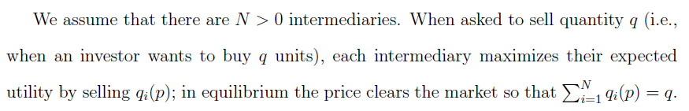

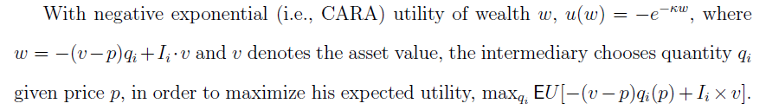
Model Assumptions – Intermediaries
Notes:
Each intermediary is maxing its utility by choosing the optimal amount to sell given price P.
W is intuitive, as it is initial inventory fair value + gain or loss from selling qi for price P = after sell inventory value=wealth.
This is solvable because the only random variable is V, and all other is constant. Just plug in unility function and By FOC we could solve.

Slide 12
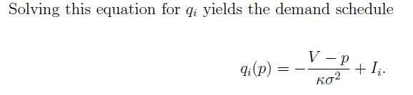
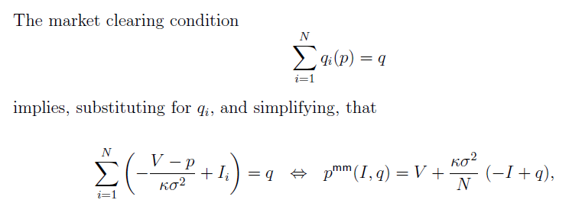
Model Assumptions – Intermediaries
V is the mean of the normal random asset value v.
Notes:
Note P(0,0)=0, the SI trade at fair value.

Slide 13

Model Assumptions – Trading Costs.
Complexity costs: contacting mass q of small investors is complex (e.g., data processing, or keeping track of offers) and costs is given by
Transaction validation costs: assume that costs accrue linearly based on the number of transactions, at a cost of γ per mass 1 number of transactions.
If a trader initiates a trade with mass q of trader IDs or uses q IDs, costs are γq. Since number of transactions is mass q.
If two parties trade mass q quantity in a single trade, the costs are zero.

Slide 14
Model Assumptions – Trading Costs.
Front-running costs: Suppose a large investor is contacted by the liquidity demander who wishes to buy a quantity q. If he chooses to front-run, this investor buys quantity q from the intermediary at a price and resells it to the liquidity demander at a higher price.
Liquidity provider charges the liquidity demander the minimum cost that the latter would incur to acquire q in the “public market” after front-runner has moved the price by purchasing q. Since now inventory for intermediaries are negative q.
Notes:
This is obvious from the price equation for intermediaries market, since inventory has go to negative.

Slide 15


Public and Transparent Setting
There is an equilibrium where large traders trade “peer-to-peer” in that sense that the liquidity demander makes an offer to the liquidity provider, for the full quantity demanded, and the latter accepts.
Equilibrium payoff: for liquidity demander and provider are
p is the price demander pays to provider to buy 1 unit of asset that has mean 0 value.

Slide 16
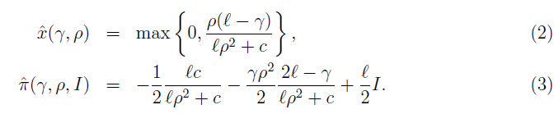
Public and Transparent Setting
Deviation strategy for liquidity demander:
liquidity demander chooses to trade with small investors and the intermediaries. the liquidity demander optimally approaches mass x(γ, ρ) of investor IDs with p = p(I, 0), and he obtains payoff π(γ, ρ, I):
Lemma 1-Deviation payoff for demander at first stage game:

Slide 17

Public and Transparent Setting
the liquidity demander chooses approaching mass X of small investors to maximize his stage game payoff from deviation strategy:
Since mass 1 of the 1/ρ small investors are interested in selling, each offer is accepted with probability ρ. When approaching measure x of small investors, the liquidity demander trades quantity ρx, at the price p(I, 0) per unit. He trades remaining (1- ρx) with intermediaries.
Equation (4) is just complexity cost + validation cost +trading with small investors costs +trading with intermediary's costs.
Solving Equation (4) by FOC gives the result in (2) and (3)
Notes:
Proof. Since mass 1 of the 1/ρ small investors are interested in selling, each offer is
accepted with probability ρ. Therefore when approaching measure x of small investors,
the liquidity demander trades quantity ρx, at the price p(I, 0) per unit, and he ad-
additionally incurs complexity cost C(x) = cx2/2 (for all offers) and validation cost γρx
(for accepted offers). The liquidity demander then trades the remaining quantity 1−ρx
with the intermediaries at the price p(I, 1−ρx) per unit; in the single-ID setting, this
transaction incurs zero validation costs. The continuation payoffs do not depend on the
quantity x, and the liquidity demander chooses x to maximize his stage game payoff:

Slide 18
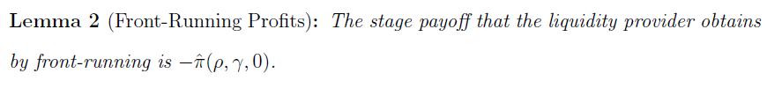
Public and Transparent Setting
Deviation strategy:
liquidity providers chooses to front-run.
Deviation payoff for demander in first stage game:

Slide 19
Public and Transparent Setting
The front-runner pays ℓ/2 to build his position in the intermediated market by purchasing 1 unit.
After being front-run, the liquidity demander solves the optimization problem as described before for I = −1, and his optimal payoff is ˆπ(γ, ρ,−1) as defined in (3).
The front-runner could then offer the liquidity demander at a price such that the liquidity demander’s payoff remains that same, ˆπ(ρ, γ,−1).
The front-runner’s payoff is then −ˆπ(ρ, γ,−1)−ℓ/2, which is just −ˆπ(ρ, γ,0)
Notes:
Facing front run, Demander’s only other choice is to trade with SI and Intermediaries, same situation in his deviation strategy, but only this time I=-1.

Slide 20

Public and Transparent Setting
Continuation Deviation payoff:
Let π = ˆπ(ρ, γ, 0) to denote the stage game payoff to the liquidity demander when he chooses to deviate
After a deviation by any large investor, the trigger strategy would prescribe that the liquidity demander only traders with the intermediaries and the small investors as a punishment.
a large investor’s stage game payoff will be π when he is the demander and 0 otherwise. Each large trader experiences a liquidity shock with probability 1/2 in each stage game, and a large trader’s continuation value after a deviation is:

Slide 21


Public and Transparent Setting
Total Deviation payoff: sum of first and continuation payoff.
Optimal Equilibrium Exists if: equilibrium payoff > deviation payoff

Slide 22

Public and Transparent Setting
Proposition 1:For all parametric configurations, there exists a price p >0 such that the large investors trade with each other in equilibrium. For δ > 2/3, the large investors trade with each other at p = 0.
Solving the previous inequalities gives below expression:
Observe that the above relation always holds for p = −π>0, therefore large investors trading with each other is always an equilibrium.
Second, for δ>2/3, the left-hand side of the inequality in (9) is negative, and p = 0 satisfies the inequality.

Slide 23

Private and Opaque Setting
In this setting, IDs of large investors cannot be identified, and therefore the liquidity demander is not able to contact the large liquidity provider directly.
This means for liquidity demander; the only strategy is the deviation strategy described in equation (2) and (3) and liquidity demander’s behavior in this setting is therefore captured by Lemma 1.
Observing equation (2), it is obvious that liquidity demanders approach and trade more with small investors if intermediaries are more risk-averse or if fundamental risk increases, and they trade less with small investors if complexity costs or validation costs increase.
Notes:
Risk averse=l (iota) fundamental risk= sigma captured by iota.
Complexity=C, Validation cost=gamma.

Slide 24
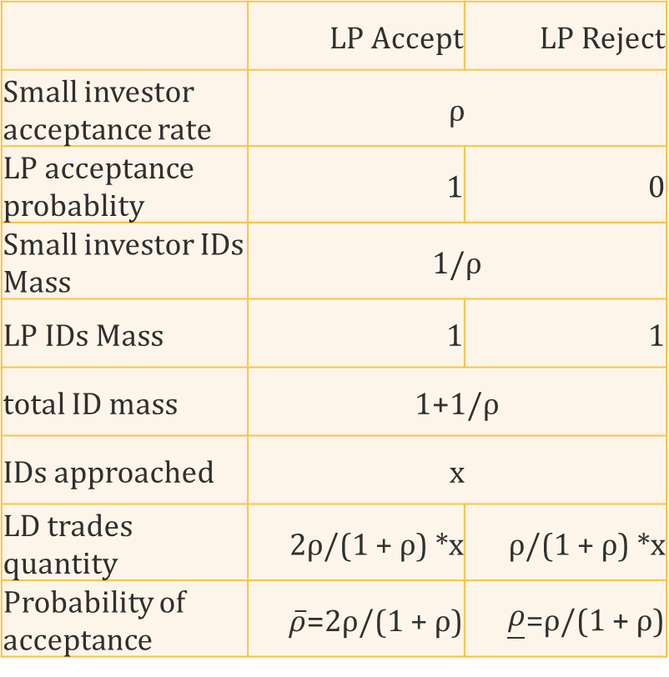
Public and Opaque Setting
There are two equilibria. The optimal equilibrium is that the liquidity demander contacts the continuum of IDs and the intermediary. The liquidity provider accepts the offer whenever contacted.
Assume each large investor has 1 mass of IDs and thus the mass of the continuum of IDs that the liquidity demander can contact is 1 + 1/ρ.
Let the probability of acceptance as which has two values as shown on the right.
 | LP Accept | LP Reject
Small investor acceptance rate | ρ
LP acceptance probablity | 1 | 0
Small investor IDs Mass | 1/ρ
LP IDs Mass | 1 | 1
total ID mass | 1+1/ρ
IDs approached | x
LD trades quantity | 2ρ/(1 + ρ) *x | ρ/(1 + ρ) *x
Probability of acceptance | $\overline{ρ}$=2ρ/(1 + ρ) | $\underline{ρ}$=ρ/(1 + ρ)

Slide 25


Public and Opaque Setting
When liquidity demander approaches mass x IDs, he maximize the following payoff, where p is the price offered.
The first term is the payoff to Small investor and large investor by trading units at price p.
The second term is complexity cost
The third term is payoff to intermediaries, trading the remaining quantity with intermediaries.
The last term is verification cost for trading 1 mass transactions.

Slide 26

Public and Opaque Setting
Overserve that equation (11) is the same as equation (4), when p=γ, ρ = $\hat{ρ}$and assuming I=0.
Plugging these numbers in solution function (2) and (3). Liquidity demander optimally approaches x(p, $\hat{ρ}$) of trader IDs, and he obtains payoff π(p, $\hat{ρ}$, 0).

Slide 27
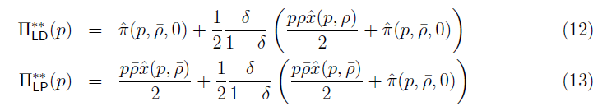

Public and Opaque Setting
There is an optimal equilibrium where large traders accept each other’s offers and do not front-run each other.
Total Equilibrium payoff:
where the probability of acceptance is $\hat{ρ}$ = 2ρ/(1 + ρ) := $\overline{ρ}$
Since Mass x*1/(1+1/ρ) =x$\overline{ρ}$/2 of liquidity provider IDs receive request, so liquidity provider payoff is x$\overline{ρ}$/2*p.
Notes:
Just plug in numbers into equation 2,3 to get first stage payoff for LD. And continuation stage is the same as first stage, just each has ½ probability to be LD or LP>

Slide 28
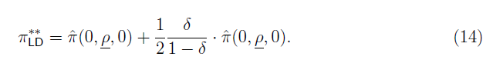
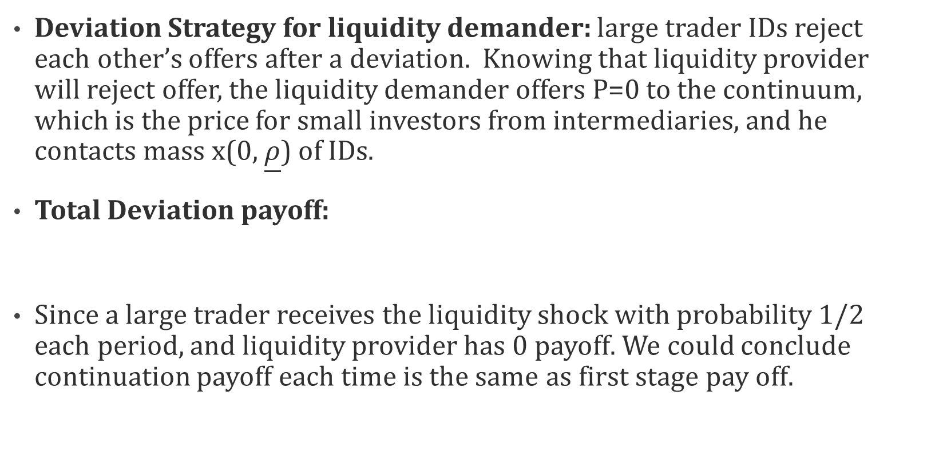
Public and Opaque Setting
Deviation Strategy for liquidity demander: large trader IDs reject each other’s offers after a deviation. Knowing that liquidity provider will reject offer, the liquidity demander offers P=0 to the continuum, which is the price for small investors from intermediaries, and he contacts mass x(0, $\underline{ρ}$) of IDs.
Total Deviation payoff:
Since a large trader receives the liquidity shock with probability 1/2 each period, and liquidity provider has 0 payoff. We could conclude continuation payoff each time is the same as first stage pay off.
Notes:
Just plugging p=0 to equation 3.

Slide 29
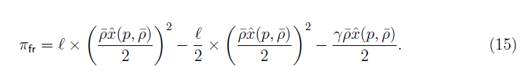
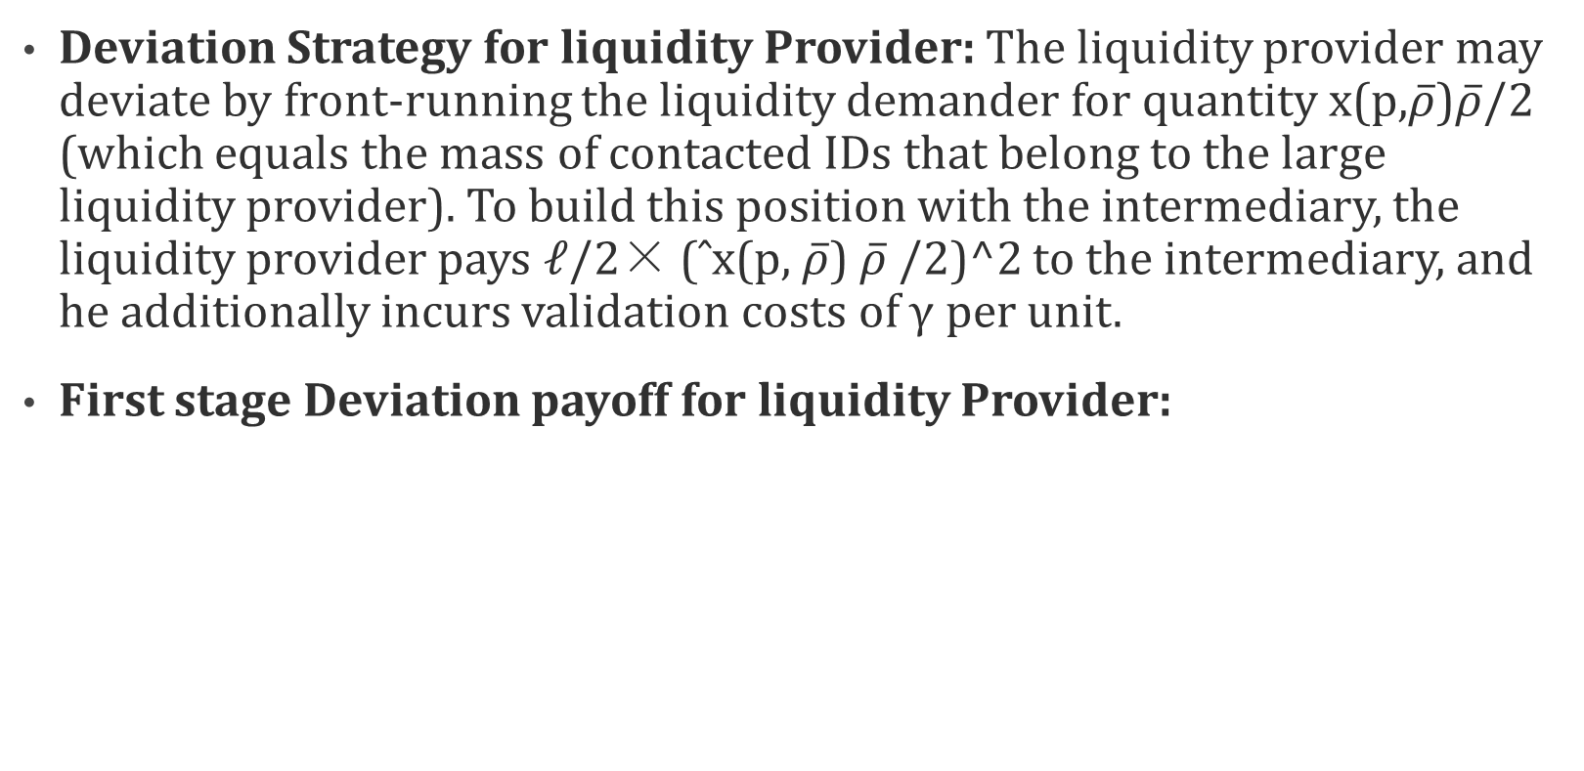
Public and Opaque Setting
Deviation Strategy for liquidity Provider: The liquidity provider may deviate by front-running the liquidity demander for quantity x(p,$\overline{ρ}$)$\overline{ρ}$/2 (which equals the mass of contacted IDs that belong to the large liquidity provider). To build this position with the intermediary, the liquidity provider pays ℓ/2× (ˆx(p, $\overline{ρ}$) $\overline{ρ}$/2)^2 to the intermediary, and he additionally incurs validation costs of γ per unit.
First stage Deviation payoff for liquidity Provider:
Notes:
For LP, this is just payoff from selling to LD, Payoff buying form Intermediaries for front run, Payoff from validation cost for buying from intermediaries.

Slide 30

Public and Opaque Setting
Once the trigger strategy is invoked, the continuation payoff for the liquidity provider is the same as for the liquidity demander.
Total Deviation payoff:
Notes:
So the continuation payoff is the same as in (14)

Slide 31

Public and Opaque Setting
Optimal Equilibrium Exists if : equilibrium payoff > deviation payoff
Solving the inequality gives the following Proposition 3:
When the intermediated market is sufficiently liquid (ℓ is sufficiently small), or when the discount factor δ is sufficiently large (the future is important), or when validation cost γ is sufficiently high, there exists a “peer-to-peer trading” equilibrium where the large liquidity demander trades with the intermediaries, the continuum of small investors, and the liquidity provider at price p = 0.

Slide 32
Welfare Comparison of Different Setting
The full transparency benchmark setting in our model is superior in terms of aggregate welfare, as there is no inefficient transfer of risk to the risk-averse intermediary and no complexity costs.
The design of validation costs is exogenous, so we make the simplifying assumption that γ = 0.
The three scenarios considered are:
  Scenario 1:In Private and Opaque design, large investor do not trade with each other.
  Scenario 2: In Public and Opaque design, large investor do not trade with each other.
  Scenario 3: In Public and Opaque design, large investor trade with each other.

Slide 33
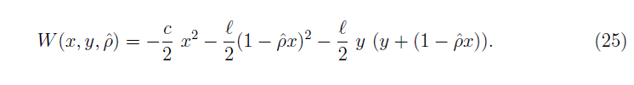

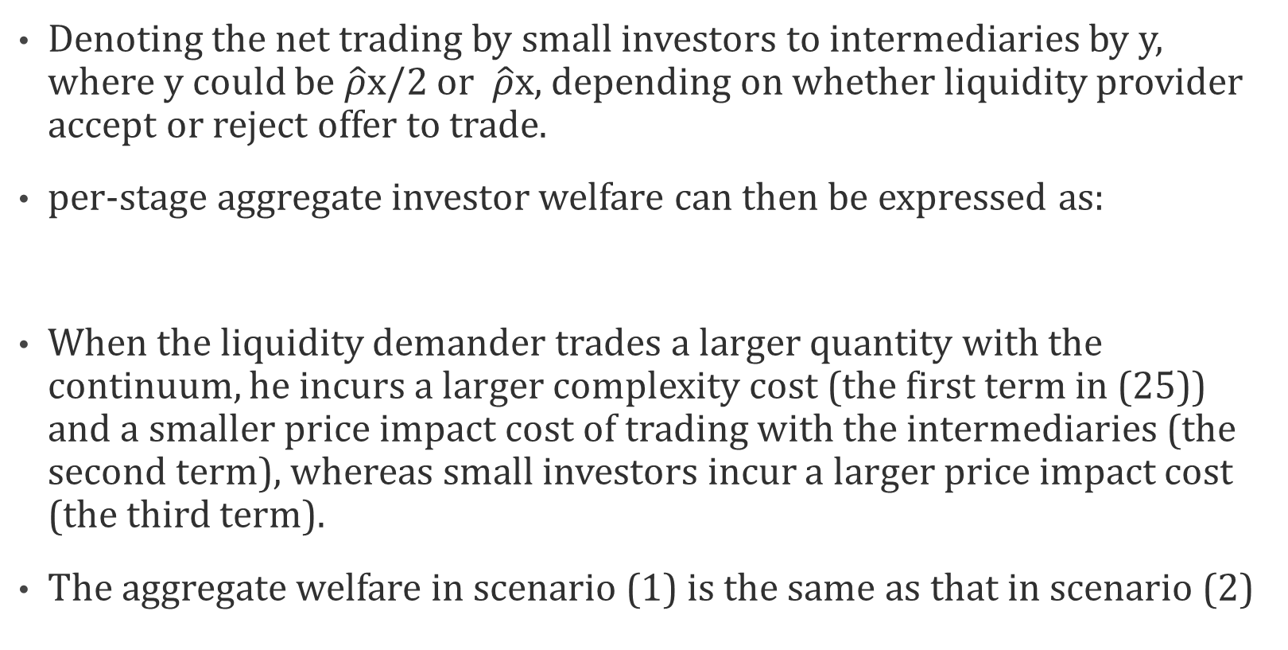
Welfare Comparison of Different Setting
Denoting the net trading by small investors to intermediaries by y, where y could be $\hat{ρ}$x/2 or $\hat{ρ}$x, depending on whether liquidity provider accept or reject offer to trade.
per-stage aggregate investor welfare can then be expressed as:
When the liquidity demander trades a larger quantity with the continuum, he incurs a larger complexity cost (the first term in (25)) and a smaller price impact cost of trading with the intermediaries (the second term), whereas small investors incur a larger price impact cost (the third term).
The aggregate welfare in scenario (1) is the same as that in scenario (2)
Notes:
Welfare is constant. Plugging the relevant x, y, Rho^ for each scenario.

Slide 34
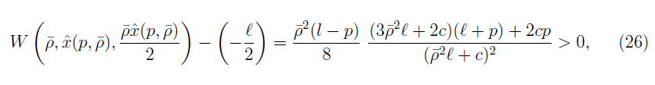

Welfare Comparison of Different Setting
Welfare in scenario 3 is higher than welfare in scenario 1.
Substituting relevant expressions for each scenario, the difference between welfare in scenario 3 and scenario is always positive as shown below.
The inequality follows since in equilibria, trading exclusively in the intermediated market is more expensive than trading with the continuum and the intermediaries. This force

Slide 35
Conclusion
By design, the optimal system is a public blockchain that offers full transparency and mandates a single, unique ID per user.
The study focus is on the role of privacy implementation and comparing two fully opaque systems.
The first is a private blockchain that achieves investor privacy by restricting the ledger visibility to the trusted parties who verify transactions; similarly to the current setup with centralized ledgers.
The second is a blockchain, where users obfuscate their holdings and behavior by using numerous digital IDs.
The study shows that the implementation of privacy on a distributed ledger has economic implications beyond simply reducing the level of transparency, and between the two fully opaque setups, the blockchain-native solution of multiple IDs is superior in terms of welfare.
Notes:
What if the liquidity provider does not want to trade? Want to take the same action? So has to trade with intermediaries. For normal market situation, it may want to trade.
What if liquidity provider cannot absorb all the quantity?
What if small investor cannot absorb all the quantity?
What if two mass of small investors all want to take same side.
What if more small investors want to sell than buy?
Limit once contact from demander per stage game.
What if there are more than two large investor.

