Slide 1
Word power: A new approach for content analysis
Author: Narasimhan Jegadeesh, Di Wu
Presented by Weiyun Xu
Instructed by Phil Dybvig

Slide 2
Outline
Introduction of content analysis
Methodology
Data Source
Results of empirical tests
Timeliness of market reaction to the tone of 10-Ks
Relation between tone of IPO prospectuses and underpricing
Discussion

Slide 3
Introduction of content analysis
1. Word List
each word is categorized as positive or negative
2. Content analysis algorithm
map descriptive content of any document into a quantitative score
In this paper, it presents a new approach to determine the strength of various words in conveying negative or positive tone

Slide 4
Methodology: define lexicon
They use the negative and positive word lists constructed by Loughranand McDonald(2011). The LM list contains 353 positive words and 2,337 negative words.
In LM list, different inflections of a word are counted as separate words. For example, the word falsify and its inflections falsifies, falsified, falsifying, falsification, and falsifications are all considered as separate words.
Expect all these inflections to have the same strength and group them together
In the end, the list reduces to 123 positive words and 718 negative words. They perform this process manually to ensure no mistakes.
Notes:
Third person singular, past tense, present progressive, noun

Slide 5
Methodology: how to map words to score
$${Score}_{i}=\sum_{j=1}^{J}{(W_{j}F_{i,j})\frac{1}{a_{i}}}$$
$$i:document i$$
$$j:word j$$
$$W_{j}:weight for word j$$
$$F_{i,j}:the number of occurrences of word j in document i$$
$$\frac{1}{a_{i}}:reflect the fact that the score is negatively related to the total number of words$$

Slide 6
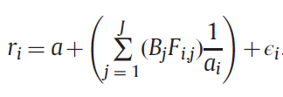
Methodology: relation between the score and the contemporaneous stock return
cannot separately estimate b and wj at this stage because the weights measure the relative strength of each word in the lexicon and the weights can be scaled arbitrarily

Slide 7
Data
Time frame: from 1995 to 2010
Sifting criteria:
1. The 10-K should be the first filing for the year by the company.
2. EDGAR identifies firms that file 10-Ks using Central Index Key (CIK).
3. Our tests use market capitalization, book-to-market ratio, and turnover as control variables. We exclude all firms for which we do not have these data for the years when the data are not available.
4. To mitigate the effect of bid-ask bounces, the stock price should beat at least $3:00 on the filing date
5. A number of words such as risk and casualty that are perceived as negative words in the context of non-financial firms might not have negative connotations for financial firms.

Slide 8
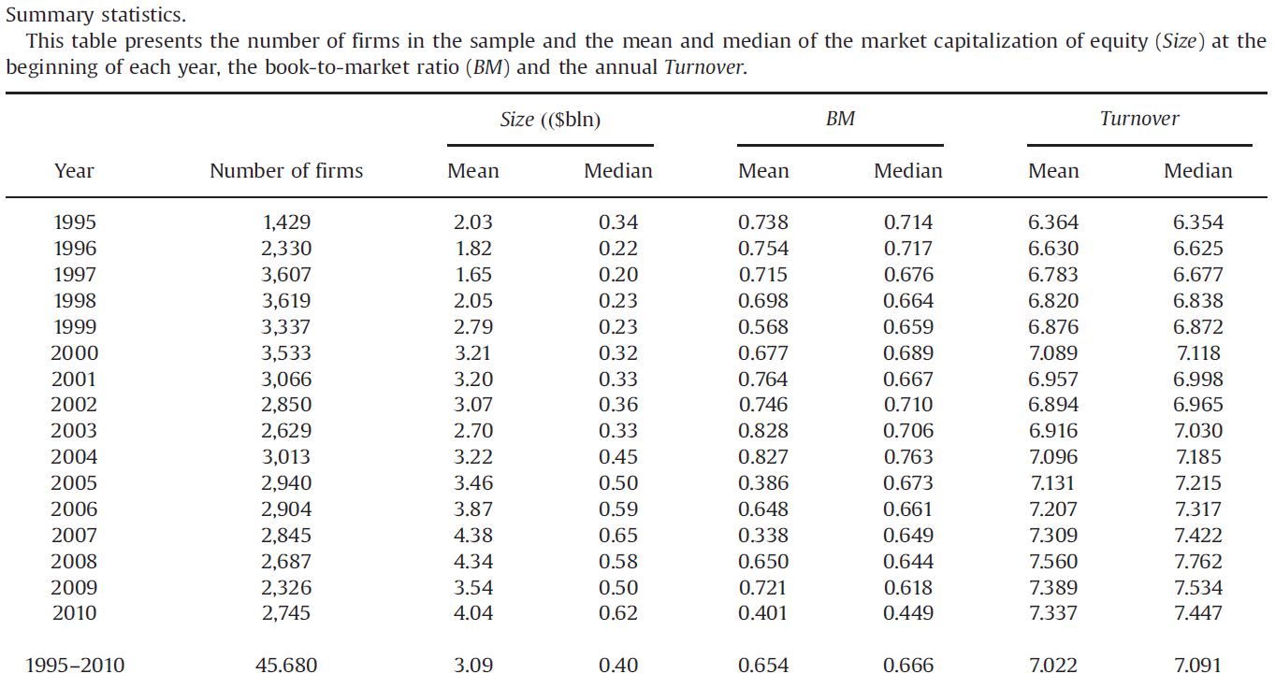
Data Summary
The final sample contains 45,860 filings between1995 and 2010 and 7,606 unique firms. The mean market value is $3,09 billion and the book-to-market ratio has a mean value of 0.65.

Slide 9
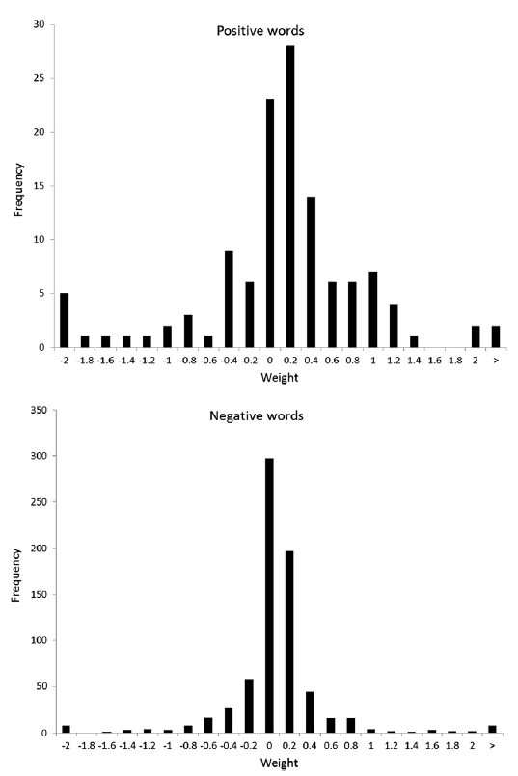
Results: Term weight estimates
It presents the distribution of standardized weights for positive and negative words estimated using the entire 1995–2010 sample period. Sixteen negative and seven positive words have an absolute magnitude of weights greater than 2, and the figure presents their combined frequencies at the extreme ends.
Notes:
. Because these are standardized weights, they are centered at zero.

Slide 10
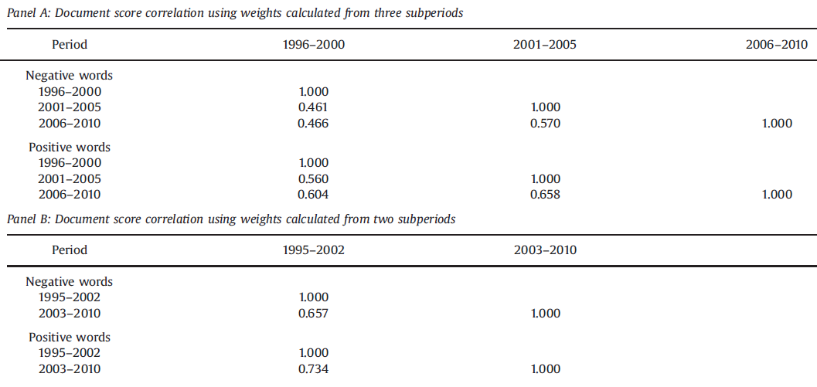
Results: Stability of document tone scores
By using longer period, the weights are estimated more precisely with longer sample periods.
These results indicate that we should use as long a sample period as possible to estimate term weights.

Slide 11
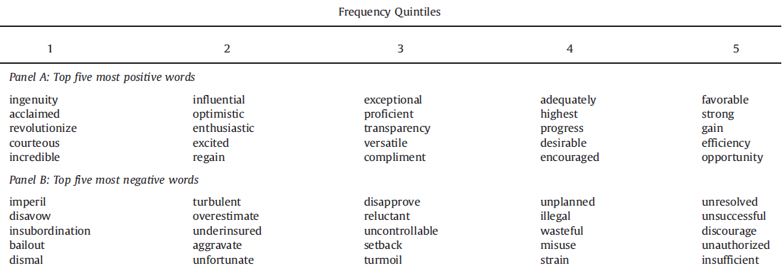
Results: Word power weights versus inverse document frequency weights
The table presents the five positive and words with the largest word power weights within each term frequency quintile.

Slide 12
Results: Determinants of tone
Size: Natural logarithm of the market capitalization of equity at the end of the month before the 10-K filing date
BM: Ratio of the book value of equity as of the fiscal year end in the 10-K
Volatility: Standard deviation of the firm-specific component of returns estimated using up to 60months of data as of the end of the month before the filing date.
Turnover: Natural logarithm of the number of shares traded during the period from 6 to252 trading days before the filing date divided by the number of shares outstanding on the filing date.
EADRet: Return over the three-day window[t-1, t+1] around the latest earnings announcement date minus the CRSP value-weight index return over the same period.
Accruals: One-year change in current assets excluding cash minus change in current liabilities excluding long-term debt in current liabilities and taxes payables minus depreciation divided by average Total assets.

Slide 13
Results: Determinants of tone

Slide 14
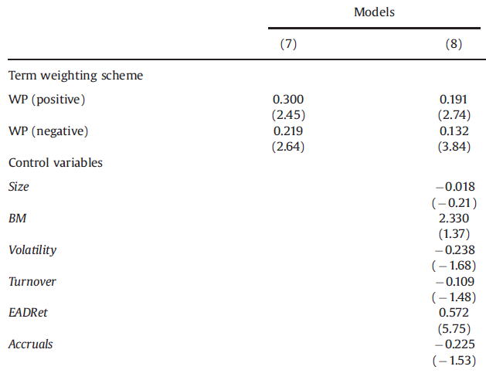
Results: Determinants of tone

Slide 15
Results: Combined lexicons
Their approach removes much of the subjectivity inherent in compiling lexicons composed of words with positive or negative connotations

Slide 16
Results: Completeness of word list
Their term weighting measure reliably quantifies tone even when presented with an incomplete word list, which in turn shows that the choice of term weighting scheme is at least as important as the completeness of the lexicon

Slide 17
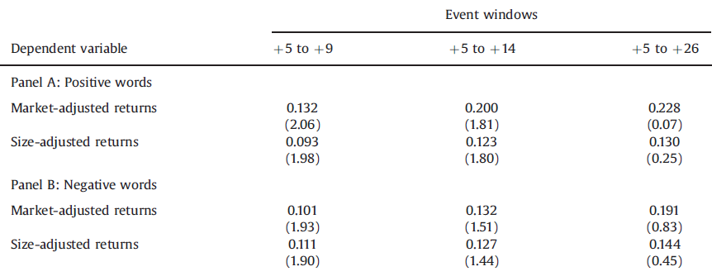
Timeliness of market reaction to tone
These results further reinforce the importance of accurately measuring the tone for fully understanding the timeliness of market’s reaction to document tone

Slide 18
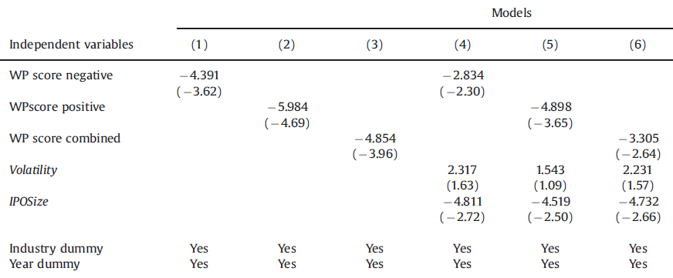
Tone of IPO prospectus and underpricing
The results support the hypothesis that the potential for downside risk is positively related to IPO under pricing. It also indicate that the term weights are useful in quantifying the tone of IPO prospectuses

Slide 19
Discussion
1. Will data incompleteness affect the result?
2. Is it appropriate to assuming linear relationships?

