Slide 1
INFORMATIVE FUND SIZE, MANAGERIAL SKILL, AND INVESTOR RATIONALITY
Author Min Zhu
Present by Kay song

Slide 2
traditional analytic framework
1. The traditional analytic framework of skill in active management builds on the assumption of constant returns to scale.
2. fund size is regarded as uninformative and randomly paired with funds
3. However, this paper believes the traditional framework that studies managerial skill and ignores size fails to fully utilize the available information, which can have biased previous studies against finding differential ability in active management

Slide 3
previous research
1. Chen et al. (2004) and Yan (2008)
negative relationship between fund size and performance.
These studies link diminishing returns to scale to liquidity constraints faced by funds
2. Elton et al. (2012)
no relationship between size and performance
they attribute to the effect of the diseconomies of returns to scale being offset by the reduction in the expense ratio as a fund increases in size
3. Ferreira et al. (2013)
diseconomies of scale for US funds but not for non-US funds

Slide 4
previous research
Problem
based on the ordinary least squares (OLS) approach that directly regresses fund returns on lagged fund sizes (omitted-variable bias)
A concern with this approach is that the validity of the model is based on the assumption that fund size is uninformative and randomly distributed among funds, the very hypothesis to be tested.

Slide 5
Research Foundation
Pástor et al. (2015)
utilize fund fixed effects to remove the omitted-variable bias.
they use an empirical strategy based on recursive demeaning procedure to ex- amine the size-performance relationship
show that performance decreases as the size of the active mutual fund industry grows
however, fail to reject the hypothesis of constant returns to scale at the individual fund level.

Slide 6
Overview of Zhu’s work
Based on work of Pástor et al. (2015).
empirical strategy suffers an inherent misspecification resulting from a model restriction that is problematic for the fund size process
this misspecification increases estimation uncertainty and reduces power in hypothesis tests.
Thus, better to use the biased OLS estimator
correcting the omitted-variable bias, which greatly increased estimating uncertainty
Due to severe skewness in dollar fund size, the logarithm of fund size is often used
Using portfolios sorted on fund size, we further show a substantial amount of individual heterogeneity in decreasing returns to scale.

Slide 7
Overview of Zhu’s work
Based on Berk and van Binsber- gen (2015)
They demonstrate that the only proper measure in a decreasing returns to scale world is the value added
study the relation between the optimal value a fund can create and the value the fund actually delivered
loglinear functional form of decreasing returns to scale
Based on Berk and van Binsbergen’s (2015) (BvB)
The value a fund actually delivered is measured by realized value added.
Investors’ fund flows ensure all managers have enough capital to extract the maximum value from capital markets, and fund managers index the excess amount if the investors provided surplus capital

Slide 8
Overview of Zhu’s work
Empirical evidence
value a typical fund actually added is far short of the optimum
On the one hand, 17% of the funds in our sample fail to have enough capital from investors to extract the optimal value
On the other hand, funds that have surplus capital, rather than index the excess money, the managers tend to actively manage more than they can handle, running the risk of destroying value
It is necessary to bear in mind here that these inferences on whether funds have enough or too much capital depend on the assumption that the relation between size and gross alpha is loglinear

Slide 9
Overview of Zhu’s work
rather than teach us something about managerial skill, net alphas teach us something about the rationality of investors and the competitiveness of financial markets.
the empirical evidence we provide indicates the existence of sophisticated investors who are capable of rational learning

Slide 10
theoretical framework
neoclassical world， Berk and Green’s (2004)
a key component in the mechanism to achieve equilibrium is decreasing returns to scale
If the net returns to investors are determined in equilibrium by competition be- tween investors, and not by the managers’ skill, then the net alpha is never a measure of skill
Recognizing that the net alpha is simply the gross alpha minus the fees and fund fees are quite stable in reality, the net alpha is also a de- creasing function of the fund size
Thus, we can gauge the rationality of investors and the competitiveness of capital markets by studying the net alpha and its relation to size

Slide 11
theoretical framework
In a decreasing returns to scale world, a positive net alpha indicates that investors have not given enough money to a particular fund, while a negative net alpha suggests that investors have given the fund too much money
In a standard rational expectations world, all net alphas are zero because positive net alphas are competed away by in- vestors, regardless of the fund’s skill level.
Berk and van Binsbergen (2015, hereafter “BvB”) further prove that the gross alpha does not measure skill either.
gross alpha is simply the fees a fund charged in equilibrium plus net alpha

Slide 12
theoretical framework
A proper measure of managerial skill has to augment information from both the fund size and the fund return
BvB’s value added measure： dollar amount of what the fund adds over the benchmark
product of the gross alpha and the fund AUM
The value added at the maximum is given q∗, the optimal amount the manager can actively manage.

Slide 13
theoretical framework
BvB show that the maximum value added can be consistently estimated with a simple measure called the realized value added
For the i-th fund, the expected value added between times t−1 and t is
Because managers optimize, they would invest at their optimal amount. This effectively means that managers index the excess money when investors provide more capital than the optimal amount q*i

Slide 14
theoretical framework
indexed money earns no alpha, the equilibrium gross alpha is given by
Therefore, the product of the gross alpha and the fund AUM is the maximum value the manager can add

Slide 15
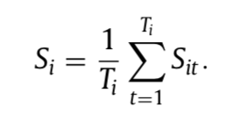
theoretical framework
For a fund that exists for Ti periods, the it estimated skill is the time series average of Sit
This is also referred to as the realized value added by BvB that consistently estimates Vi∗ under the standard neoclas- sical assumptions
The realized value added is not only intuitive but also robust in the sense that it holds regardless of the functional form of the decreasing returns to scale

Slide 16
theoretical framework
Summarize
the question of whether and how much mutual fund managers are skilled is an entirely different question from the question of whether investors share in the fruits of the managers’ skill.
The first question can be answered only by the value added measure, and the second question can be answered with the net alpha measure.

Slide 17
Data of Zhu’s work
Morningstar over the period from January 1995 to December 2014
To avoid survivorship bias, we include live and dead funds
Restrict the analysis to actively managed domestic equity-only funds in US markets
aggregate all share classes of the same fund
adjust all fund AUM numbers by inflation， express them in January 1, 2014 dollars
drop funds with fewer than two years of data

Slide 18
Data of Zhu’s work
also assume that a fund’s benchmark beta is equal to one
construct two performance measures: the benchmark- adjusted gross return and the benchmark-adjusted net return
To remove outliers, we only use data betwen its 1st and 99th percentiles

Slide 19
Fund-level returns to scale
relationship between fund size and performance
fund size proxies
dollar amount of the fund AUM
logarithm of the fund AUM
β is supposed to be negative A nonnegative β implies a fund’s investment strategy is infinitely scalable. Put an- other way, such a fund is a positive NPV investment opportunity regardless of its size. Conversely, an infinitely large fund would become the market and hence a zero gross alpha

Slide 20
Fund-level returns to scale
relationship between fund size and performance
error term uit = si + εit
si reflects individual fund skill
If cov(xi , si )!= 0 , putting si into the error term leads to a biased estimate of β (omitted- variable bias)
can be fixed by including a fund fixed effect

Slide 21
Fund-level returns to scale
fixed effect
Although the lagged size xit−1 and the next period return innovation εit are independent, there is a positive contemporaneous correlation between the fund size and the unexpected return.
Because of this contemporaneous correlation, a demeaning process induces a correlation between the demeaned regressor and the demeaned innovation, which, in turn, causes a finite-sample bias in a fixed-effects estimate of the scale effect β
To remove the finite sample bias in the fixed-effects estimator, Pástor et al. (2015) use Moon and Phillips’s (2000) recursive demeaning (RD) process.

Slide 22
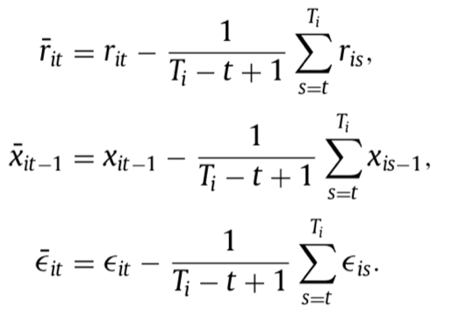
Fund-level returns to scale
Some mathematical derivation for RD estimators

Slide 23
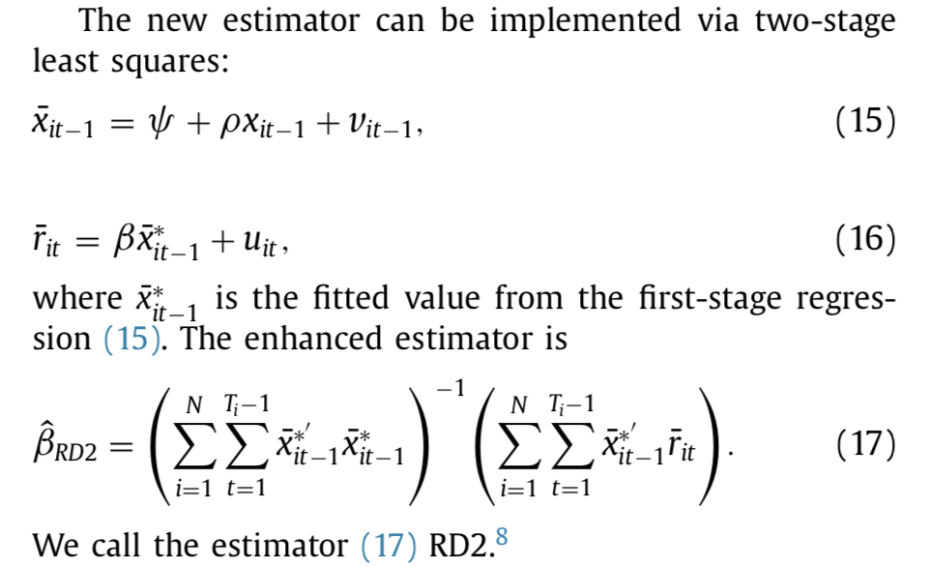
Fund-level returns to scale
RD2 estimator
A new estimator that Zhu proposed in this paper

Slide 24
Fund-level returns to scale
Simulations for four estimators
Bias, hypothesis testing, standard deviation and the root mean square error (RMSE) of the estimators
simple OLS estimator (OLS)
omitted-variable bias
fixed-effects estimator (FE)
correct omitted-variable bias
Shows inite-sample bias
RMSE is less than OLS

Slide 25
Fund-level returns to scale
Simulations for four estimators
Bias, hypothesis testing, standard deviation and the root mean square error (RMSE) of the estimators
RD1
correct finite-sample bias
Increase omitted-variable bias
RMSE is higher than FE
RD2
correct two bias
RMSE is the least

Slide 26
Fund-level returns to scale
null hypothesis: beta is zero
FE : rejecting the null in 65–78% of simulations
RD1 lacks sufficient power to reject the null : 13–17%
RD2 possesses adequate power to reject the null when the null is false: is greater than 90%
Why?
inclusion of an intercept in the first-stage regression
stronger instrument by using a more recent fund size measure.

Slide 27
Fund-level returns to scale
Diseconomies of scale
Linear
OLS estimate: fund size is negative when gross performance is used but positive when net performance is in place.
FE estimator are highly significant and negative for gross and net performance.
The RD1 estimator yields a negative point estimate. The estimator is, however, unable to reject the null of no relationship with t-statistics of −0.34 and −0.32 on the gross and net performance, respectively.
RD2. The estimated effect of fund size on performance is negative and statistically significant at the 5% level

Slide 28
Fund-level returns to scale
Diseconomies of scale
The average fund-level decreasing returns to scale parameter estimated on the full sample, however, provides an incomplete picture of decreasing returns to scale in the data
We sort the mu-tual funds based on the decile rankings of their average AUM calculated over the sample period.
consider both linear and loglinear functional forms, The relation between a fund’s size and its gross performance is significantly negative across all deciles

Slide 29
Value added
measure skill in active management using value added
Assumptions
loglinear relationship between gross alpha and fund size

Slide 30
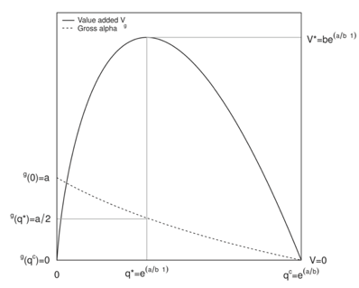
Value added
measure skill in active management using value added
full dynamics of the gross alpha and the value added as a function of the active fund size

Slide 31
Value added
measure skill in active management using value added
Reduce the estimation error, we sort funds into ten portfolios by fund size and estimate b using the panel estimator RD2 in each decile portfolio.
This implementation choice assumes that all the funds in a portfolio share the same b value, this method actually increases the accuracy of the b estimate because of the sharp reduction in estimation errors.

Slide 32
investor rationality and the market competitiveness
rather than teaching us something about managerial skill, the net alpha teaches us something about the rationality of investors and the competitiveness of markets ,
We examine whether investors can allocate their money to where it is most productive both in cross-section and over the typical lifetime of a fund

Slide 33
investor rationality and the market competitiveness
Cross-sectional investor rationality
Each month, flag a fund whether it is in equilibrium , offers additional or destroys value to decide if negative net alpha or not
compute the annual net capital flows in each fund
If investors’ learning is effective, we would expect the fraction of funds with inflows higher in the positive net alpha group and lower in the negative net alpha group, relative to the benchmark trend
Results: they appear to be able to quickly learn and shift their capital to chase positive NPV opportunities

Slide 34
investor rationality and the market competitiveness
Ideas
rather than teaching us something about managerial skill, the net alpha teaches us something about the rationality of investors and the competitiveness of markets
We examine whether investors can allocate their money to where it is most productive both in cross-section and over the typical lifetime of a fund.

Slide 35
investor rationality and the market competitiveness
Investor rationality over a fund’s lifetime
Each month, flag whether investors have put the right amount of money with the i-th fund at time t or not
logit regression results shows chance that investors have not given a fund enough money (a positive net alpha) significantly decreases over a fund’s lifetime

Slide 36
Conclusion
Fund performance is negatively related to fund size
Best estimators for regression is RD2 compared to OLS, FE and RD1
Best indicator for managers skill is value added instead of fund performance
Net alpha offers insights into investor rationality and the market competitiveness

